Slide 1
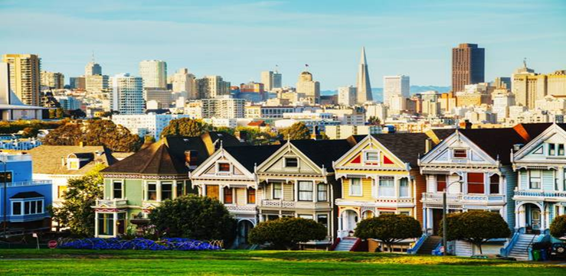
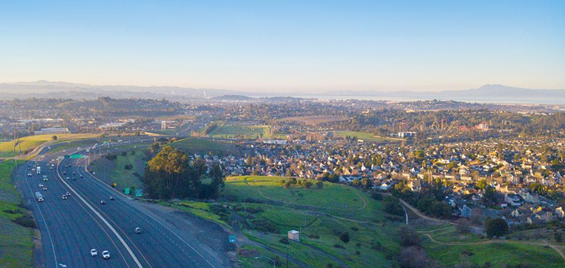
としん こうがい ひかく
都心と郊外の比較
AP Japanese compare and contrast Essay Prompts

Slide 2

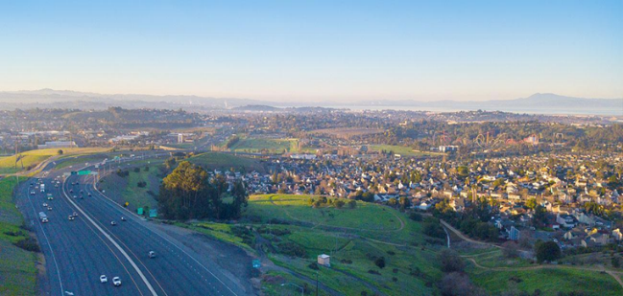
としん toshin こうがい kougai
都心 郊外
Urban Areas Suburban Areas

Slide 3



今から、都心と郊外を比べます。
交通、生活環境、家の広さの３つの点で
大きな違いがあります。
いま としん こうがい くら
こうつう せいかつかんきょう いえ ひろ みっつ てん
おお ちが

Slide 4
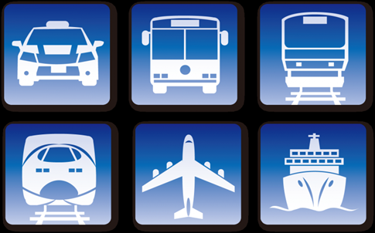
ひと ちが こうつう
一つめの違い：交通

Slide 5
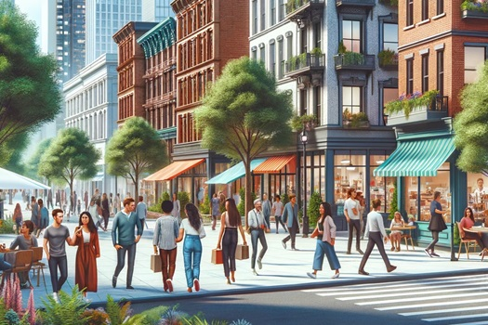
としん でんしゃ おお
都心は電車やバスが多いです。
車がなくても生活できます。
駅が近くて、
歩いて買い物や食事に行くことができます。
くるま せいかつ
えき ちか
ある か もの しょくじ い

Slide 6
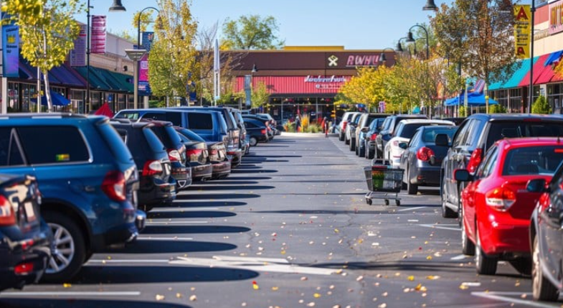
郊外は交通が不便です。
電車やバスが少ないです。
人びとは 車にのります。
こうがい こうつう ふべん
でんしゃ すく
ひと くるま

Slide 7

ふた ちが せいかつかんきょう
二つめの違い：生活環境

Slide 8
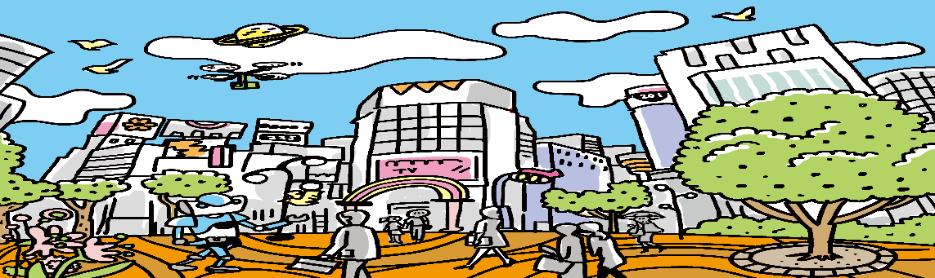
としん みせ おお べんり
都心は店やレストランが多くて便利です。
しかし、にぎやかで人が多く、夜もうるさいです。
ひと おお よる

Slide 9
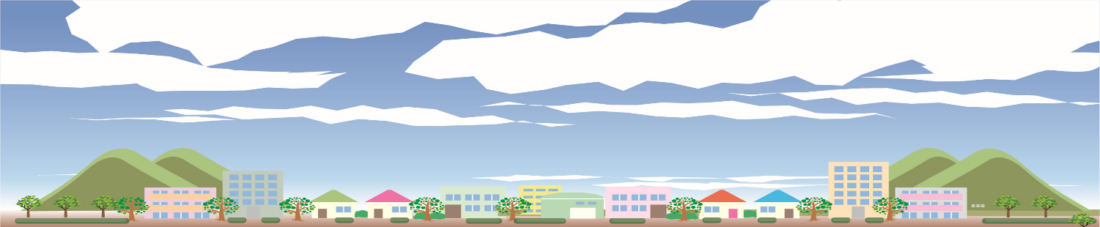
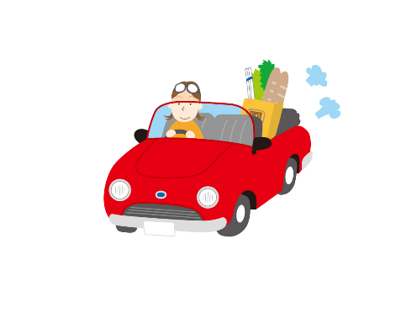
郊外は自然が多くて静かです。
大きな公園や広い校庭があります。 けれども、買い物には車で行きます。
こうがい しぜん おお しず
おお こうえん ひろ こうてい
か もの くるま い

Slide 10

みっ ちが いえ ひろ
三つめの違い：家の広さ

Slide 11
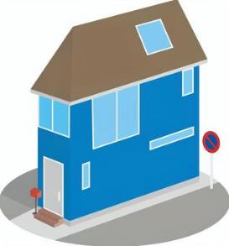

都心は土地が高く、家が狭いです。
郊外は同じお金で広い家に住むことができます。
そのため郊外は家族に人気です。
としん とち たか いえ せま
こうがい おな かね ひろ いえ す
こうがい かぞく にんき

Slide 12
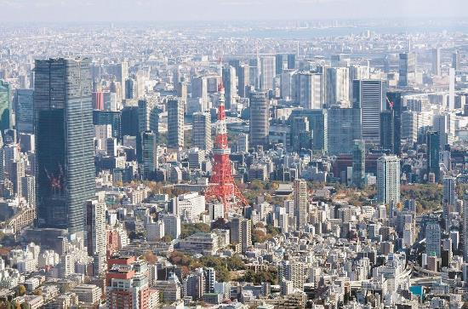
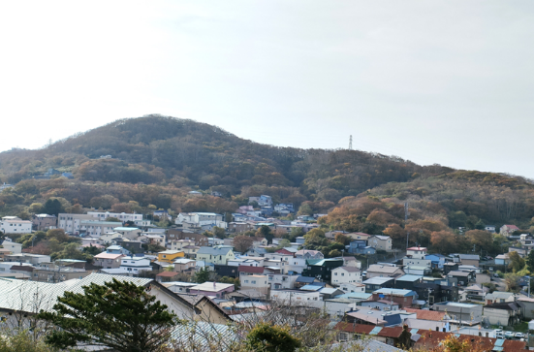
結論
都心は交通が便利ですが、うるさくて家が狭いです。 郊外は静かで広い家に住めますが、交通が不便です。
としん こうつう べんり いえ せま
こうがい しず ひろ いえ す こうつう ふべん

Slide 13
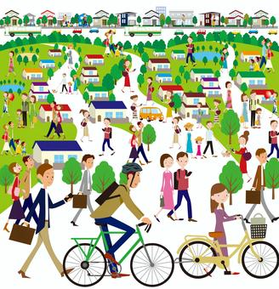

わたし す
私はハイキングが好きです。
自然に近い家がいいので、
郊外に住みたいです。
しぜん ちか いえ
こうがい す

Slide 14
This compare-and-contrast essay follows the standard AP Japanese Free Response Writing format, making it easy to read and understand.
It's important to practice the FRQ portion, here is sample prompt!
*Remember this is only an example and answers can vary!

Slide 15
都心と郊外の比較
としん こうがい ひかく
Comparison of Urban and Suburban Areas
AP Japanese compare and contrast Essay Prompts

Slide 16
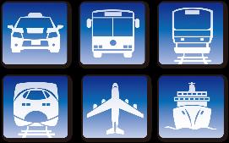


今から、都心と郊外を比べます。
交通、生活環境、家の広さの３つの点で
大きな違いがあります。
いま としん こうがい くら
こうつう せいかつかんきょう いえ ひろ みっつ てん
おお ちが
Now, I will compare urban areas (cities) and suburban areas. There are three big differences: transportation, living environment, and housing size.

Slide 17
1. Introduction (導入)
「今から、都心と郊外を比べます。」 → Clearly states the topic of the essay (comparing urban and suburban life).
「交通、生活環境、家の広さの３つの点で大きな違いがあります。」 → Introduces the three comparison points (transportation, living environment, and housing size).
✅ Why is this good?
Short and simple introduction, making it easy to understand.
Clearly outlines the three comparison points, helping organize the essay.

Slide 18
ひと ちが こうつう
一つめの違い：交通
First Difference: Transportation

Slide 19
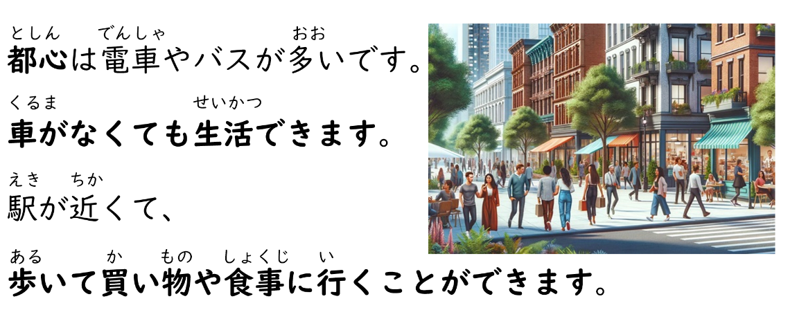
Urban areas have many trains and buses, so people can live without a car. Stations are nearby, and people can walk to go shopping or eat out.

Slide 20
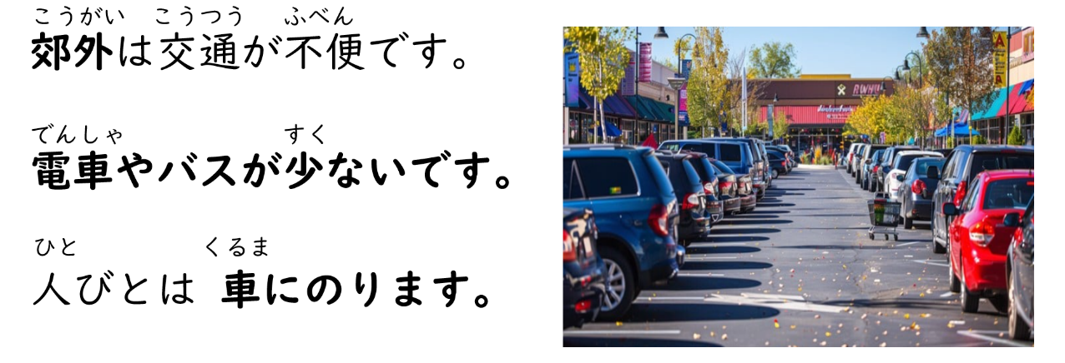
Suburban areas have inconvenient transportation. There are fewer trains and buses, and people use cars.

Slide 21
2. First Point: Transportation (交通)
Urban Areas (都心)
「都心は電車やバスが多いです。車がなくても生活できます。」 → There are many trains and buses. People can live without a car.
「駅が近く、歩いて買い物や食事に行くことができます。」 → Stations are nearby, and people can walk to shops and restaurants.
Suburban Areas (郊外)
「郊外は交通が不便です。電車やバスが少ないです。」 → Public transportation is inconvenient. There are fewer trains and buses.
「人びとは車にのります。」
→ People use cars.
✅ Why is this good?
Short, clear sentences that make the comparison easy to understand.
Uses simple grammar but still expresses the main differences between urban and suburban transportation.

Slide 22
ふた ちが せいかつかんきょう
二つめの違い：生活環境
Second Difference: Living Environment

Slide 23
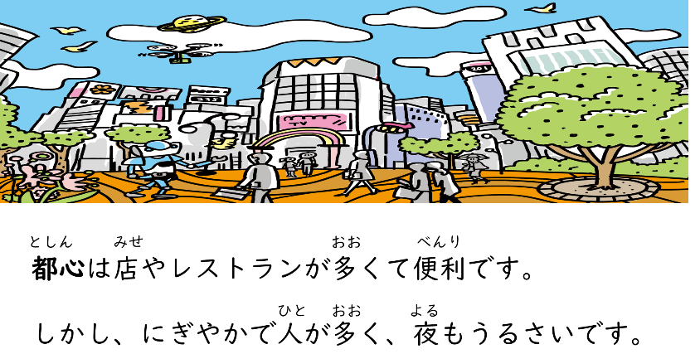
Urban areas have many stores and restaurants, which is convenient.
However, they are crowded, noisy, and busy even at night.

Slide 24
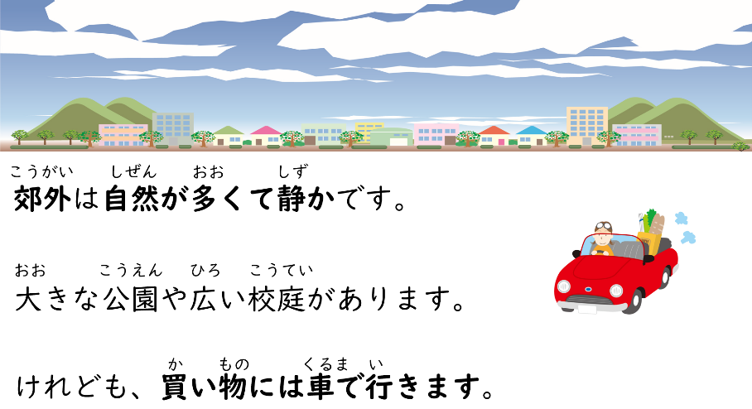
Suburban areas have a lot of nature and are quiet.
There are large parks and spacious schoolyards.
However, people must drive to go shopping.

Slide 25
3. Second Point: Living Environment (生活環境)
Urban Areas (都心)
「都心は店やレストランが多くて便利です。
しかし、にぎやかで人が多く、夜もうるさいです。」 → There are many shops and restaurants, which is convenient, but it is crowded and noisy at night.
Suburban Areas (郊外)
「郊外は自然が多くて静かです。」 「大きな公園や広い校庭があります。」 → There is a lot of nature, and it is quiet. → There are large parks and big schoolyards.
「けれども、買い物に車で行きます。」 → However, people must use a car to go shopping.
✅ Why is this good?
Simple vocabulary and grammar make it easy to understand.
Clearly shows the difference between urban and suburban environments.
Mentions a key challenge of suburban life (needing a car for shopping).

Slide 26
みっ ちが いえ ひろ
三つめの違い：家の広さ
Third Point: Housing

Slide 27
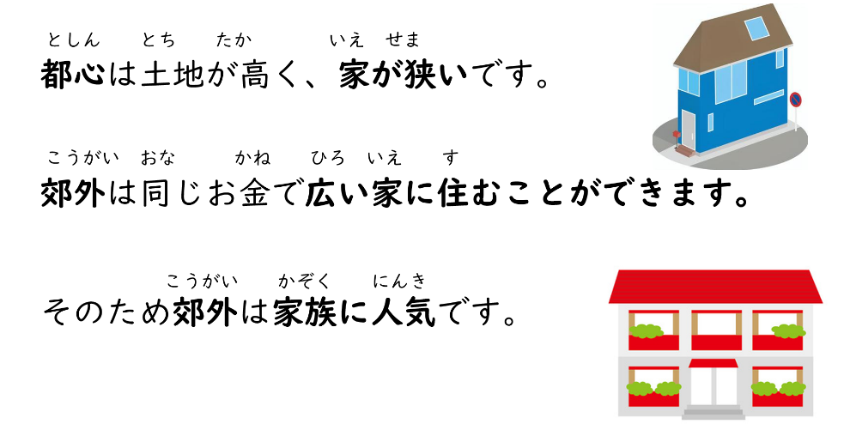
In urban areas, land is expensive, and houses are small.
In suburban areas, people can live in a bigger house for the same price. Because of this, suburban areas are popular among families.

Slide 28
4. Third Point: Housing Size (家の広さ)
Urban Areas (都心)
「都心は土地が高く、家が狭いです。」 → Land is expensive, and houses are small.
Suburban Areas (郊外)
「郊外は同じお金で広い家に住めます。」 → For the same amount of money, people can live in a bigger house.
「そのため、郊外は家族に人気です。」 → Because of this, suburbs are popular for families.
✅ Why is this good?
Uses simple comparison words like 「同じお金で」 (for the same price), making the point clear.
Mentions a key reason why people move to the suburbs (more space for the same cost).

Slide 29
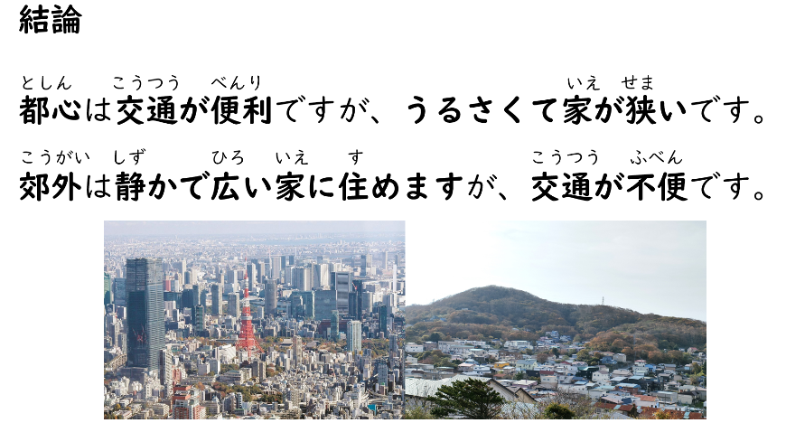
Conclusion
Urban areas have convenient transportation, but they are noisy, and houses are small.
Suburban areas are quiet and have bigger houses, but transportation is not convenient.

Slide 30
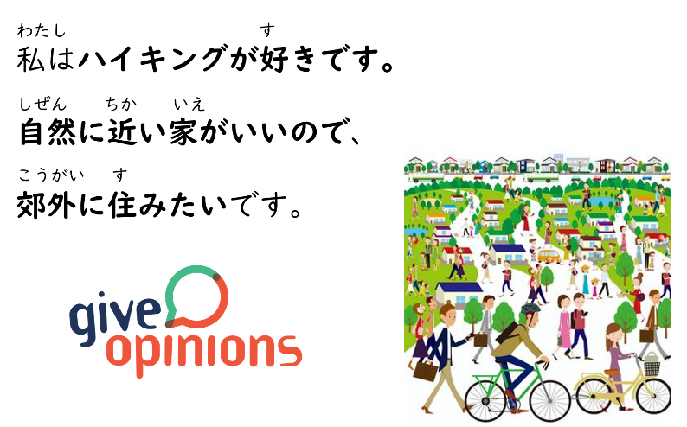
I like hiking. I want to live in the suburbs because I prefer a house close to nature.

Slide 31
Why is this a Strong Conclusion?
✅ Summarizes Key Differences Clearly
The first two sentences briefly restate the main differences between urban and suburban areas.
This ensures the reader remembers the key points before moving to the opinion.
✅ States a Clear Personal Opinion
The sentence 「私はハイキングが好きです。」 (I like hiking) introduces a personal preference.
The next sentence 「自然に近い家がいいので、郊外に住みたいです。」 (I want to live in the suburbs because I prefer a house close to nature) logically connects the preference to the choice of suburban living.
✅ Uses a Simple and Logical Justification
The reasoning connects nature and hiking to suburban living.
This makes the opinion more personal and persuasive without unnecessary complexity.

Slide 32
How to Write a Strong Compare & Contrast Essay
Requirement | How this response meets it
Compares two topics clearly | ✅ Uses three key points (transportation, living environment, housing size)
Uses logical organization | ✅ Introduction → 3 Comparison Points → Conclusion
Balanced comparison | ✅ Both positive and negative aspects of city and suburban life are included
Gives an opinion | ✅ Clearly states a preference for the suburbs and explains why
Uses appropriate grammar & vocabulary | ✅ Uses simple grammar but still includes some AP-level kanji (都心, 交通, 郊外, 買い物, 静か, 家族, 費用, 便利) It's okay if you don't use all of them.
Concise and easy to understand | ✅ Short sentences and clear structure make it easy to read

Slide 33
Why Learning Adjective Usage is Important
This essay shows why using adjectives correctly is important for clear and effective writing. Here’s why:

Slide 34
1️⃣ Adjectives Describe Key Differences
The essay compares urban and suburban areas, so adjectives help explain the differences.
都心は交通が便利です。
うるさいです。
家がせまい。
(Cities have convenient transportation but are noisy and have small houses.)
郊外は静かです。
広い家に住むことができます。
交通が不便です。
(Suburbs are quiet and have big houses, but transportation is inconvenient.)
Without adjectives like 便利 べんり (convenient), うるさい (noisy), 狭い せまい (small), 静か しずか (quiet), 広い ひろい (spacious), 不便 ふべん (inconvenient), these comparisons would not be clear or effective.

Slide 35
2️⃣ Adjectives Make Opinions Stronger
The conclusion uses adjectives to express personal preference:
私はハイキングが好きです。
自然に近い家がいいので、郊外に住みたいです。 (I like hiking. I want a house close to nature, so I want to live in the suburbs.)
近い (close) makes the reason more specific.
If adjectives were missing, the opinion would feel weak or unclear.

Slide 36
3️⃣ Adjective Forms Change Sentence Meaning
The essay uses adjective conjunctions, such as:
べんりですが (convenient but)
しずかで (quiet and)
うるさく（て） (noisy and)

Slide 37
Final Thought
✔ Adjectives help make comparisons clear. ✔ They strengthen opinions. ✔ Using the correct form makes writing smooth and natural.
By understanding how to use adjectives properly, students can write better essays and express their ideas more clearly! 🎌🔥

Slide 38

